Slide 1
Lecture 4: Informed Heuristic Search
ICS 271 Fall 2006

Slide 2
Summary
Heuristics and Optimal search strategies
  heuristics
  hill-climbing algorithms
  Best-First search
  A*: optimal search using heuristics
  Properties of A*
    admissibility,
    monotonicity,
    accuracy and dominance
    efficiency of A*
  Branch and Bound
  Iterative deepening A*
  Automatic generation of heuristics

Slide 3
Problem: finding a Minimum Cost Path
Previously we wanted an arbitrary path to a goal or best cost.
Now, we want the minimum cost path to a goal G
  Cost of a path = sum of individual transitions along path
Examples of path-cost:
  Navigation
    path-cost = distance to node in miles
      minimum => minimum time, least fuel
  VLSI Design
    path-cost = length of wires between chips
      minimum => least clock/signal delay
  8-Puzzle
    path-cost = number of pieces moved
      minimum => least time to solve the puzzle

Slide 4
Heuristic functions
8-puzzle
8-queen
Travelling salesperson

Slide 5
Heuristic functions
8-puzzle
  W(n): number of misplaced tiles
  Manhatten distance
  Gaschnig’s
8-queen
Travelling salesperson

Slide 6
Heuristic functions
8-puzzle
  W(n): number of misplaced tiles
  Manhatten distance
  Gaschnig’s
8-queen
  Number of future feasible slots
  Min number of feasible slots in a row
  Min number of conflicts (in complete assignments states)
Travelling salesperson
  Minimum spanning tree
  Minimum assignment problem

Slide 7

Heuristics
E.g., for the 8-puzzle:
h₁(n) = number of misplaced tiles
h₂(n) = total Manhattan distance
(i.e., no. of squares from desired location of each tile)
h₁(S) = ?
h₂(S) = ?

Slide 8
Heuristics
E.g., for the 8-puzzle:
h₁(n) = number of misplaced tiles
h₂(n) = total Manhattan distance
(i.e., no. of squares from desired location of each tile)
h₁(S) = ? 8
h₂(S) = ? 3+1+2+2+2+3+3+2 = 18

Slide 9
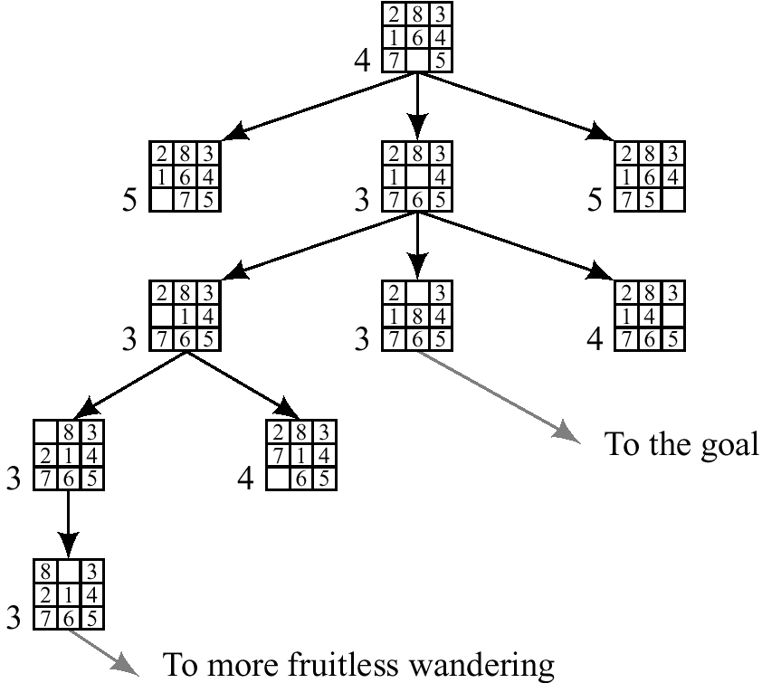
Best first (Greedy) search: f(n) = number of misplaced tiles

Slide 10
Hill climbing, Greedy search
Example:
  8-queen, traveling salesperson, 8-puzzle, finding routes
Not systematic,
  based on local optimization, memoryless, used by humans
Uses an heuristic evaluation function
  that evaluates how far we are from the goal
Very greedy:
  Expand current node and select the best among its children only if it is better than its own value until found a solution or reached a plateau. Keep only current node.
Greedy:
  Expand current node and select the best among its children. Keep current path

Slide 11

Romania with step costs in km

Slide 12
Greedy best-first search
Evaluation function f(n) = h(n) (heuristic)
= estimate of cost from n to goal
e.g., h_{SLD}(n) = straight-line distance from n to Bucharest
Greedy best-first search expands the node that appears to be closest to goal

Slide 13

Greedy best-first search example

Slide 14


Greedy best-first search example

Slide 15

Greedy best-first search example

Slide 16

Greedy best-first search example

Slide 17
Problems with Greedy Search
Not complete
Get stuck on local minimas and plateaus,
Irrevocable,
Infinite loops
Can we incorporate heuristics in systematic search?

Slide 18
Informed search - Heuristic search
How to use heuristic knowledge in systematic search?
Where ? (in node expansion? hill-climbing ?)
Best-first:
  select the best from all the nodes encountered so far in OPEN.
  “good” use heuristics
Heuristic estimates value of a node
  promise of a node
  difficulty of solving the subproblem
  quality of solution represented by node
  the amount of information gained.
f(n)- heuristic evaluation function.
  depends on n, goal, search so far, domain

Slide 19
A* search
Idea: avoid expanding paths that are already expensive
Evaluation function f(n) = g(n) + h(n)
g(n) = cost so far to reach n
h(n) = estimated cost from n to goal
f(n) = estimated total cost of path through n to goal

Slide 20

A* search example

Slide 21

A* search example

Slide 22

A* search example

Slide 23

A* search example

Slide 24

A* search example

Slide 25

A* search example

Slide 26
A*- a special Best-first search
Goal: find a minimum sum-cost path
Notation:
  c(n,n’) - cost of arc (n,n’)
  g(n) = cost of current path from start to node n in the search tree.
  h(n) = estimate of the cheapest cost of a path from n to a goal.
  Special evaluation function: f = g+h
f(n) estimates the cheapest cost solution path that goes through n.
  h*(n) is the true cheapest cost from n to a goal.
  g*(n) is the true shortest path from the start s, to n.
If the heuristic function, h always underestimate the true cost (h(n) is smaller than h*(n)), then A* is guaranteed to find an optimal solution.

Slide 27
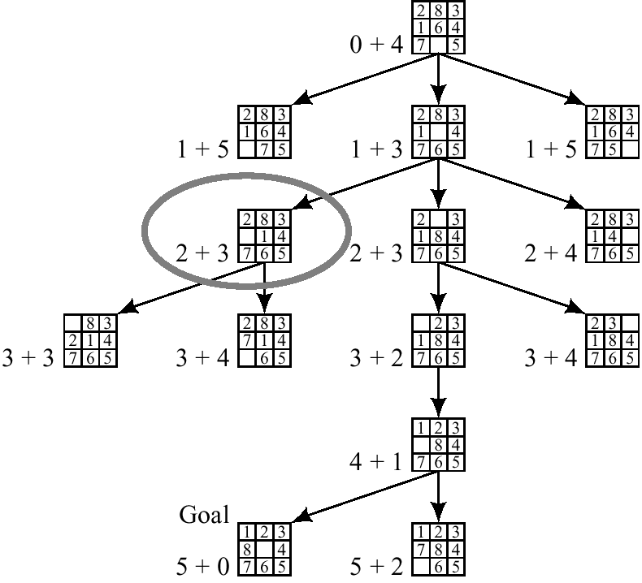
A* on 8-puzzle with h(n) = w(n)

Slide 28
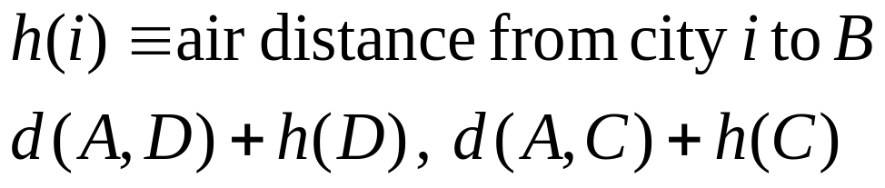
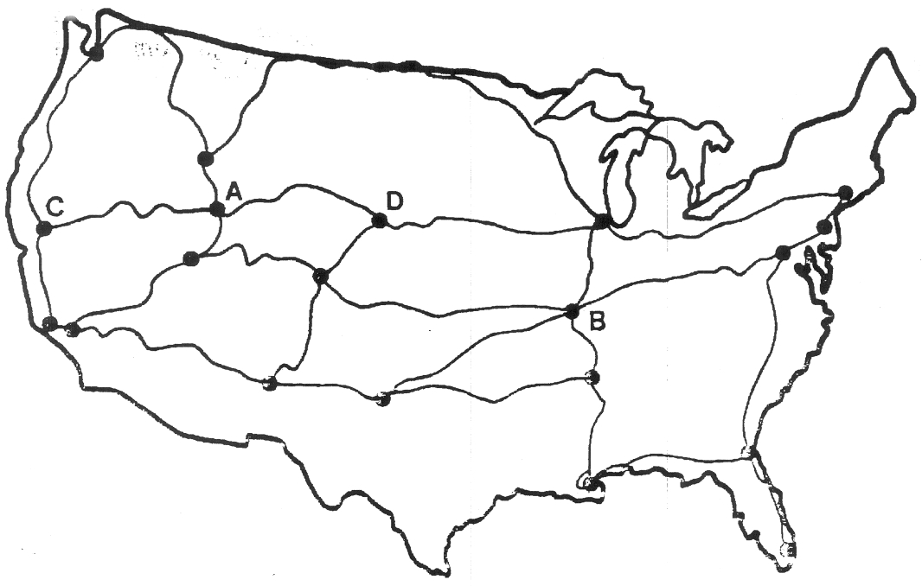
The Road-Map
Find shortest path between city A and B

Slide 29
Algorithm A* (with any h on search Graph)
Input: an implicit search graph problem with cost on the arcs
Output: the minimal cost path from start node to a goal node.
  1. Put the start node s on OPEN.
  2. If OPEN is empty, exit with failure
  3. Remove from OPEN and place on CLOSED a node n having minimum f.
  4. If n is a goal node exit successfully with a solution path obtained by tracing back the pointers from n to s.
  5. Otherwise, expand n generating its children and directing pointers from each child node to n.
    For every child node n’ do
      evaluate h(n’) and compute f(n’) = g(n’) +h(n’)= g(n)+c(n,n’)+h(n)
      If n’ is already on OPEN or CLOSED compare its new f with the old f and attach the lowest f to n’.
      put n’ with its f value in the right order in OPEN
  6. Go to step 2.

Slide 30
Best-First Algorithm BF (*)
1. Put the start node s on a list called OPEN of unexpanded nodes.
2. If OPEN is empty exit with failure; no solutions exists.
3. Remove the first OPEN node n at which f is minimum (break ties arbitrarily), and place it on a list called CLOSED to be used for expanded nodes.
4. Expand node n, generating all it’s successors with pointers back to n.
5. If any of n’s successors is a goal node, exit successfully with the solution obtained by tracing the path along the pointers from the goal back to s.
6. For every successor n’ on n:
a. Calculate f (n’).
b. if n’ was neither on OPEN nor on CLOSED, add it to OPEN. Attach a
pointer from n’ back to n. Assign the newly computed f(n’) to node n’.
c. if n’ already resided on OPEN or CLOSED, compare the newly
computed f(n’) with the value previously assigned to n’. If the old
value is lower, discard the newly generated node. If the new value is lower, substitute it for the old (n’ now points back to n instead of to its previous predecessor). If the matching node n’ resided on CLOSED, move it back to OPEN.
Go to step 2.
* With tests for duplicate nodes.

Slide 31
1
4
A
B
C
2
S
2
5
G
5
3
2
4
D
E
F
A
10.4
B
C
6.7
4.0
11.0
G
S
8.9
3.0
6.9
D
E
F

Slide 32
Example of A* Algorithm in action
S
5 + 8.9 = 13.9
2 +10.4 = 12..4
A
D
3 + 6.7 = 9.7
B
D
4 + 8.9 = 12.9
7 + 4 = 11
8 + 6.9 = 14.9
C
E
E
6 + 6.9 = 12.9
Dead End
B
F
10 + 3.0 = 13
11 + 6.7 = 17.7
G
13 + 0 = 13

Slide 33
Behavior of A - Termination
The heuristic function h(n) is called admissible if h(n) is never larger than h*(n), namely h(n) is always less or equal to true cheapest cost from n to the goal.
A* is admissible if it uses an admissible heuristic, and h(goal) = 0.
Theorem (completeness) (Hart, Nillson and Raphael, 1968)
  A* always terminates with a solution path (h is not necessarily admissible) if
    costs on arcs are positive, above epsilon
    branching degree is finite.
Proof: The evaluation function f of nodes expanded must increase eventually (since paths are longer and costier) until all the nodes on an optimal path are expanded .

Slide 34
Behavior of A* - Completeness
Theorem (completeness for optimal solution) (HNL, 1968):
  If the heuristic function is admissible than A* finds an optimal solution.
Proof:
  1. A* will expand only nodes whose f-values are less (or equal) to the optimal cost path C* (f(n) is less-or-equal C*).
  2. The evaluation function of a goal node along an optimal path equals C*.
Lemma:
  Anytime before A* terminates there exists and OPEN node n’ on an optimal path with f(n’) <= C*.

Slide 35

Consistent (monotone) heuristics
A heuristic is consistent if for every node n, every successor n' of n generated by any action a,
h(n) ≤ c(n,a,n') + h(n')
If h is consistent, we have
f(n') = g(n') + h(n')
= g(n) + c(n,a,n') + h(n')
≥ g(n) + h(n)
= f(n)
i.e., f(n) is non-decreasing along any path.
Theorem: If h(n) is consistent, f along any path is non-decreasing.
Corollary: the f values seen by A* are non-decreasing.

Slide 36
Consistent heuristics
If h is monotone and h(goal)=0 then h is addimisible
  Proof: (by induction of distance from the goal)
An A* guided by consistent heuristic finds an optimal paths to all expanded nodes, namely g(n) = g*(n) for any closed n.
  Proof: Assume g(n) > g*(n) and n expanded along a non-optimal path.
  Let n’ be the shallowest OPEN node on optimal path p to n →
  g(n’) = g*(n’) and therfore f(n’)=g*(n’)+h(n’)
  Due to monotonicity we get f(n’) <=g*(n’)+k(n’,n)+h(n)
  Since g*(n) = g*(n’)+k(n’,n) along the optimal path, we get that
  f(n’) <= g*(n) + h(n)
  And since g(n) > g*(n) then f(n’) < g(n)+h(n) = f(n), contradiction

Slide 37

A* with consistent heuristics
A* expands nodes in order of increasing f value
Gradually adds "f-contours" of nodes
Contour i has all nodes with f=f_{i}, where f_{i} < f_{i+1}

Slide 38
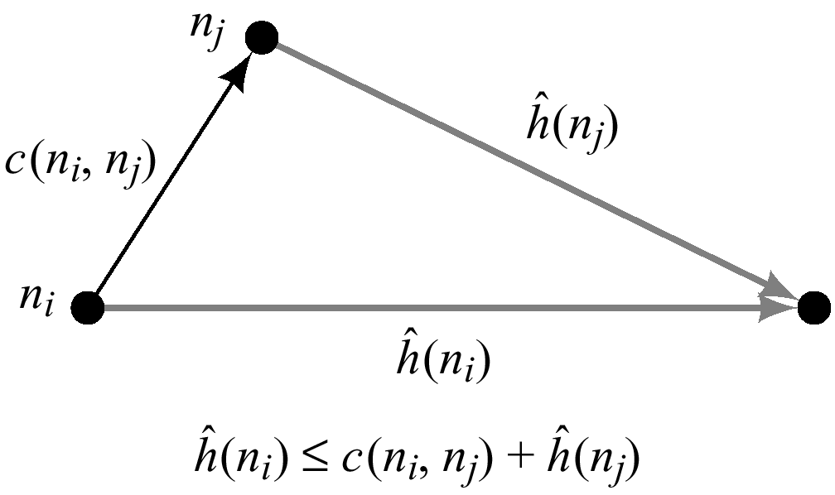
Summary of Consistent (Monotone) Heuristics
If in the search graph the heuristic function satisfies triangle inequality for every n and its child node n’: h(ni) less or equal h(nj) + c(ni,nj)
when h is monotone, the f values of nodes expanded by A* are never decreasing.
When A* selected n for expansion it already found the shortest path to it.
When h is monotone every node is expanded once (if check for duplicates).
Normally the heuristics we encounter are monotone
  the number of misplaced ties
  Manhattan distance
  air-line distance

Slide 39
Admissible and consistent? heuristics
E.g., for the 8-puzzle:
h₁(n) = number of misplaced tiles
h₂(n) = total Manhattan distance
(i.e., no. of squares from desired location of each tile)
h₁(S) = ?
h₂(S) = ?

Slide 40
Admissible and consistent? heuristics
E.g., for the 8-puzzle:
h₁(n) = number of misplaced tiles
h₂(n) = total Manhattan distance
(i.e., no. of squares from desired location of each tile)
h₁(S) = ? 8
h₂(S) = ? 3+1+2+2+2+3+3+2 = 18

Slide 41
Dominance and pruning power of heuristics
Definition:
  A heuristic function h dominates h’ (more informed than h) if both are admissible and for every node n, h(n) is (strictly) greater than h’(n).
Theorem (Hart, Nillson and Raphale, 1968):
  An A* search with a dominating heuristic function h has the property that any node it expands is also expanded by A* with h’.
Question: Is manhattan distance more informed than the number of misplaced tiles?
Extreme cases
  h = 0
  h = h*

Slide 42
Dominance
If h₂(n) ≥ h₁(n) for all n (both admissible)
then h₂ dominates h₁
h₂ is better for search
Typical search costs (average number of nodes expanded):
d=12 IDS = 3,644,035 nodes
A*(h₁) = 227 nodes
A*(h₂) = 73 nodes
d=24 IDS = too many nodes
A*(h₁) = 39,135 nodes
A*(h₂) = 1,641 nodes

Slide 43
Summary of properties
A* expands every path along which f(n) < C*
A* will never expand any node s.t. f(n) > C*
If h is monotone A* will expand any node such that f(n) <C*
Therefore A* expands all the nodes for which f(n) < C* and a subset of the nodes for which f(n) = C*.
Therefore if h1(n) < h2(n) clearly the subset of nodes expanded is smaller.

Slide 44
Non-admissible heuristics:
Adjust weights of g and h
F_w(n) = (1-w) g(n) +w h(n)
W = 0 (uniform cost)
W=1/2 (A*)
W=1 (DFS greedy)
If h is admissible then f_w is admissible for 0 <=w<=1/2

Slide 45
Complexity of A*
A* is optimally efficient (Dechter and Pearl 1985):
  It can be shown that all algorithms that do not expand a node which A* did expand (inside the contours) may miss an optimal solution
A* worst-case time complexity:
  is exponential unless the heuristic function is very accurate
If h is exact (h = h*)
  search focus only on optimal paths
Main problem: space complexity is exponential
Effective branching factor:
  logarithm of base (d+1) of average number of nodes expanded.

Slide 46
Effectiveness of A* Search Algorithm
Average number of nodes expanded
d IDS A*(h1) A*(h2)
2 10 6 6
4 112 13 12
8 6384 39 25
12 364404 227 73
14 3473941 539 113
20 ------------ 7276 676
Average over 100 randomly generated 8-puzzle problems
h1 = number of tiles in the wrong position
h2 = sum of Manhattan distances

Slide 47
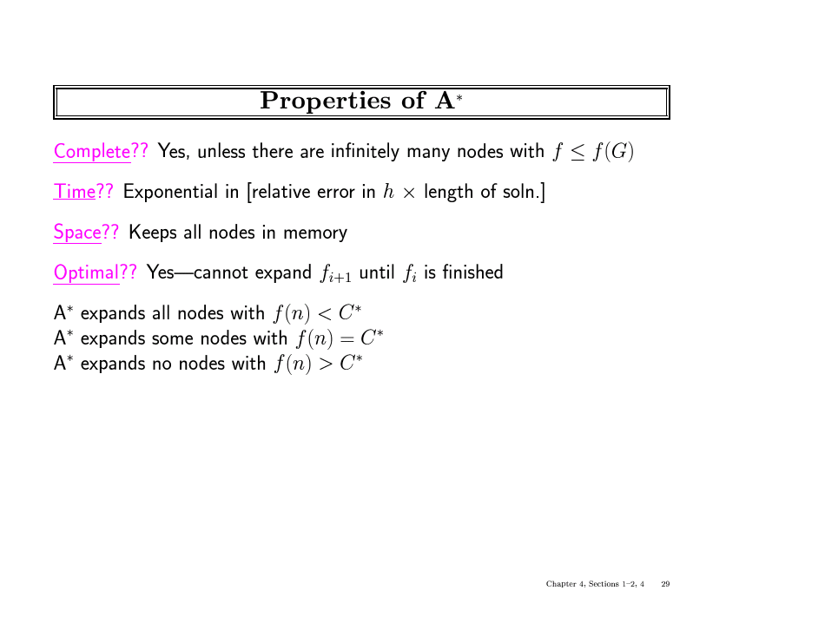

Slide 48
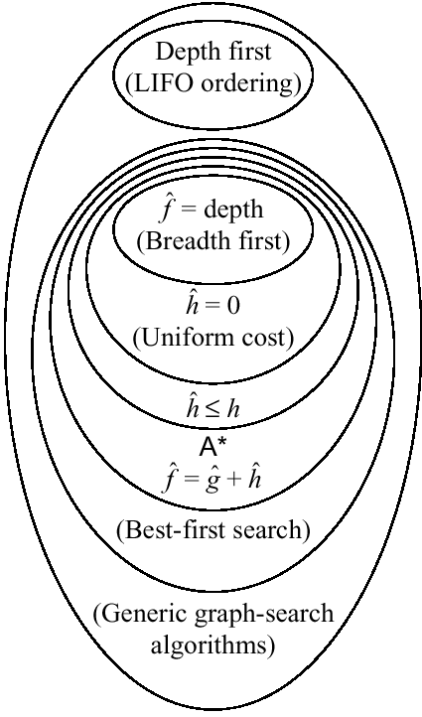
Relationships among search algorithms

Slide 49
Pseudocode for Branch and Bound Search
(An informed depth-first search)
Initialize: Let Q = {S}
While Q is not empty
pull Q1, the first element in Q
if Q1 is a goal compute the cost of the solution and update
L <-- minimum between new cost and old cost
else
child_nodes = expand(Q1),
<eliminate child_nodes which represent simple loops>,
For each child node n do:
evaluate f(n). If f(n) is greater than L discard n.
end-for
Put remaining child_nodes on top of queue in the order of their evaluation function, f.
end
Continue

Slide 50
1
4
A
B
C
2
S
2
5
G
5
3
2
4
D
E
F
A
10.4
B
C
6.7
4.0
11.0
G
S
8.9
3.0
6.9
D
E
F

Slide 51
Example of Branch and Bound in action
S
2
5
A
D

Slide 52
Properties of Branch-and-Bound
Not guaranteed to terminate unless has depth-bound
Optimal:
  finds an optimal solution
Time complexity: exponential
Space complexity: linear

Slide 53
Iterative Deepening A* (IDA*)
(combining Branch-and-Bound and A*)
Initialize: f <-- the evaluation function of the start node
until goal node is found
  Loop:
    Do Branch-and-bound with upper-bound L equal current evaluation function f.
    Increment evaluation function to next contour level
  end
continue
Properties:
  Guarantee to find an optimal solution
  time: exponential, like A*
  space: linear, like B&B.

Slide 54
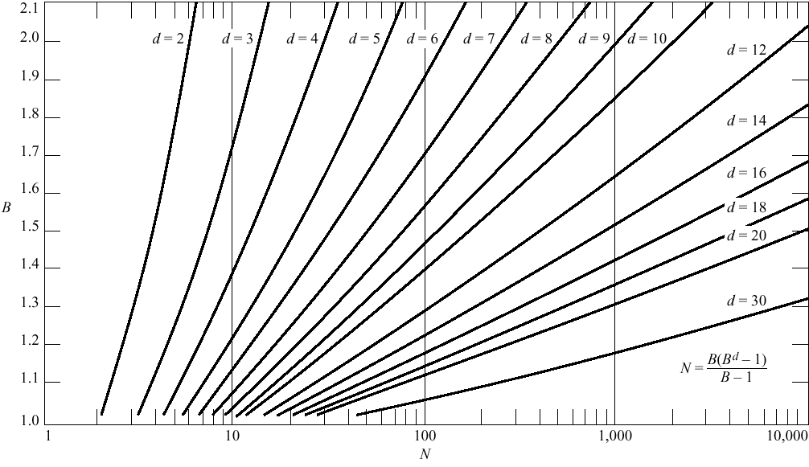

Slide 55
Inventing Heuristics automatically
Examples of Heuristic Functions for A*
  the 8-puzzle problem
    the number of tiles in the wrong position
      is this admissible?
    the sum of distances of the tiles from their goal positions, where distance is counted as the sum of vertical and horizontal tile displacements (“Manhattan distance”)
      is this admissible?
  How can we invent admissible heuristics in general?
    look at “relaxed” problem where constraints are removed
      e.g.., we can move in straight lines between cities
      e.g.., we can move tiles independently of each other

Slide 56
Inventing Heuristics Automatically (continued)
How did we
  find h1 and h2 for the 8-puzzle?
  verify admissibility?
  prove that air-distance is admissible? MST admissible?
Hypothetical answer:
  Heuristic are generated from relaxed problems
  Hypothesis: relaxed problems are easier to solve
In relaxed models the search space has more operators, or more directed arcs
Example: 8 puzzle:
  A tile can be moved from A to B if A is adjacent to B and B is clear
  We can generate relaxed problems by removing one or more of the conditions
    A tile can be moved from A to B if A is adjacent to B
    ...if B is blank
    A tile can be moved from A to B.

Slide 57
Relaxed problems
A problem with fewer restrictions on the actions is called a relaxed problem
The cost of an optimal solution to a relaxed problem is an admissible heuristic for the original problem
If the rules of the 8-puzzle are relaxed so that a tile can move anywhere, then h₁(n) (number of misplaced tiles) gives the shortest solution
If the rules are relaxed so that a tile can move to any adjacent square, then h₂(n) (Manhatten distance) gives the shortest solution

Slide 58
Generating heuristics (continued)
Example: TSP
Find a tour. A tour is:
  1. A graph
  2. Connected
  3. Each node has degree 2.
Eliminating 3 yields MST.

Slide 59
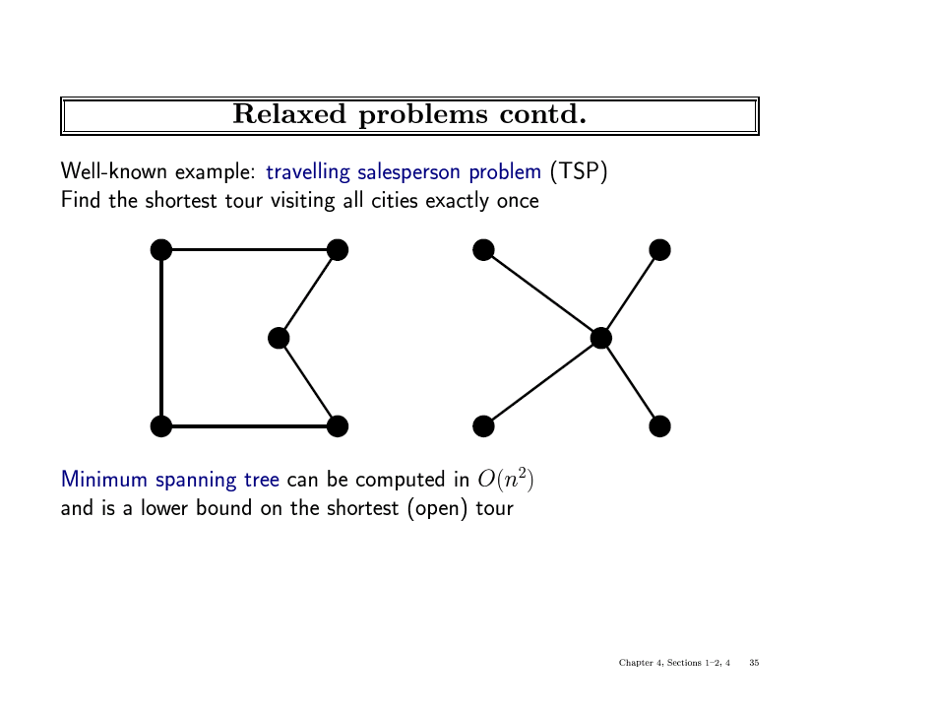

Slide 60
Automating Heuristic generation
Use Strips representation:
Operators:
  Pre-conditions, add-list, delete list
8-puzzle example:
  On(x,y), clear(y) adj(y,z) ,tiles x1,…,x8
States: conjunction of predicates:
  On(x1,c1),on(x2,c2)….on(x8,c8),clear(c9)
Move(x,c1,c2) (move tile x from location c1 to location c2)
  Pre-cond: on(x1,c1), clear(c2), adj(c1,c2)
  Add-list: on(x1,c2), clear(c1)
  Delete-list: on(x1,c1), clear(c2)
Relaxation:
1. Remove from prec-cond: clear(c2), adj(c2,c3) → #misplaced tiles
2. Remove clear(c2) → manhatten distance
3. Remove adj(c2,c3) → h3, a new procedure that transfer to the empty location a tile appearing there in the goal

Slide 61
Heuristic generation
The space of relaxations can be enriched by predicate refinements
Adj(y,z) iff neigbour(y,z) and same-line(y,z)
The main question: how to recognize a relaxed problem which is easy.
A proposal:
  A problem is easy if it can be solved optimally by a greedy algorithm
Theorem: Heuristics that are generated from relaxed models are consistent.
Proof: h is true shortest path in a relaxed model
  h(n) <=c’(n,n’)+h(n’) (c’ are shortest distances in relaxed graph)
  c’(n,n’) <=c(n,n’)
  → h(n) <= c(n,n’)+h(n’)
Problem: not every relaxed problem is easy, often, a simpler problem which is more constrained will provide a good upper-bound.

Slide 62
Improving Heuristics
If we have several heuristics which are non dominating we can select the max value.
Reinforcement learning.
Pattern Databases

Slide 63
Pattern Databases
For sliding tiles and Rubic’s cube
For a subset of the tiles compute shortest path to the goal using breadth-first search
For 15 puzzles, if we have 7 fringe tiles and one blank, the number of patterns to store are 16!/(16-8)! = 518,918,400.
For each table entry we store the shortest number of moves to the goal from the current location.
Use different subsets of tiles and take the max heuristic during IDA* search. The number of nodes to solve 15 puzzles was reduced by a factor of 346 (Culberson and Schaeffer)
How can this be genaralized? (a possible project)

Slide 64
Problem-reduction representations
AND/OR search spaces
Decomposable production systems (Natural language parsing)
  Initial database: (C,B,Z)
  Rules: R1: C →(D,L)
  R2: C→ (B,M)
  R3: B→ (M,M)
  R4: Z → (B,B,M)
  Find a path generating a string with M’s only.
The tower of Hanoi
    To move n disks from peg 1 ro3 using 2
    Move n-1 pegs to 2 via 3,
    move the nth peg to 3,
    move n-1 pegs from 2 to 3 via 1.

Slide 65
AND/OR Graphs
Nodes represent subproblems
  And links represent subproblem decompositions
  OR links represent alternative solutions
  Start node is initial problem
  Terminal nodes are solved subproblems
Solution graph
  It is an AND/OR subgraph such that:
  1. It contains the start node
  2. All it terminal nodes (nodes with no successors) are solved primitive problems
  3. If it contains and AND node L, it must contain the entire group of
  AND links that leads to children of L.

Slide 66
Algorithms searching AND/OR graphs
All algorithms generalize using hyper-arc suscessors rather than simple arcs.
AO*: is A* that searches AND/OR graphs for a solution subgraph.
The cost of a solution graph is the sum cost of it arcs. It can be defined recursively as: k(n,N) = c_n+k(n1,N)+…k(n_k,N)
h*(n) is the cost of an optimal solution graph from n to a set of goal nodes
H(n) is an admissible heuristic for h*(n)
Monotonicity:
h(n)<= c+h(n1)+…h(nk) where n1,…nk are successors of n
AO* is guaranteed to find an optimal solution when it terminates if the heuristic function is admissibleIs h is

Slide 67
Local search algorithms
In many optimization problems, the path to the goal is irrelevant; the goal state itself is the solution
State space = set of "complete" configurations
Find configuration satisfying constraints, e.g., n-queens
In such cases, we can use local search algorithms
keep a single "current" state, try to improve it
Constant space. Good for offline and online search

Slide 68
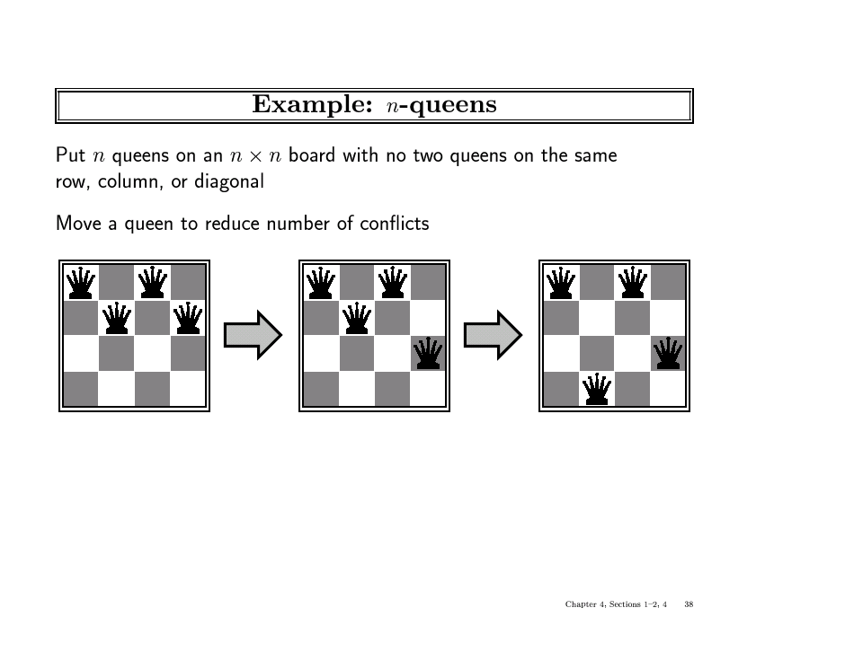

Slide 69

Hill-climbing search
"Like climbing Everest in thick fog with amnesia"

Slide 70

Hill-climbing search
Problem: depending on initial state, can get stuck in local maxima

Slide 71

Hill-climbing search: 8-queens problem
A local minimum with h = 1

Slide 72

Simulated annealing search
Idea: escape local maxima by allowing some "bad" moves but gradually decrease their frequency

Slide 73
Properties of simulated annealing search
One can prove: If T decreases slowly enough, then simulated annealing search will find a global optimum with probability approaching 1
Widely used in VLSI layout, airline scheduling, etc

Slide 74
Summary
In practice we often want the goal with the minimum cost path
Exhaustive search is impractical except on small problems
Heuristic estimates of the path cost from a node to the goal can be efficient in reducing the search space.
The A* algorithm combines all of these ideas with admissible heuristics (which underestimate) , guaranteeing optimality.
Properties of heuristics:
  admissibility, monotonicity, dominance, accuracy
Reading
  R&N Chapter 4.

